Slide 1

Employee Data Analysis using Excel
: Lokeshwari B
STUDENT NAME
REGISTER NO:
DEPARTMENT
COLLEGE
122200931, 7039ED77C17605586A144CF0C5B54C96
: Bachelor of Commerce (Corporate Secretaryship)
: K.C.S. Kasi Nadar College of Arts & Science
1
Notes:
1

Slide 2

PROJECT TITLE
Employee Productivity Analysis using Excel
2

Slide 3



AGENDA
Problem Statement
Project Overview
End Users
Our Solution and Proposition
Dataset Description
Modelling Approach
Results and Discussion
Conclusion
3/21/2024 Annual Review
3

Slide 4

PROBLEM STATEMENT
✓
The objective is to analyze the relationship between the completion rate of projects and the corresponding feedback scores, identifying any correlations or discrepancies that might exist.
✓
The objective here is to compare salary levels across different positions (Analyst, Intern, Junior Developer, Manager, etc.) and assess whether there are any significant differences between male and female employees' salaries within the same positions.
✓
The overall productivity of the project, as represented by the pie chart. The goal is to analyze the distribution and identify which components are performing optimally and which may need improvement."
4

Slide 5

PROJECT OVERVIEW
The primary goal of this project is to conduct a comprehensive analysis of the employee dataset to gain insights into various aspects such as productivity, salary distribution, project completion rates, and feedback scores across different departments and job positions. The analysis aims to identify trends, disparities, and areas for improvement within the organization.
5

Slide 6

WHO ARE THE END USERS?
• Human Resources (HR) Team
• Department Managers and Team Leads
• Senior Management and Executives
• Finance Department
• Employees
6

Slide 7
OUR SOLUTION AND ITS VALUE PROPOSITION
✓
✓
✓
✓
✓
✓
✓
Alignment : Alignment is crucial for making data more readable and presentable.
Filtering : To fit data into equations, change the size of rows and columns, or shrink a worksheet to fit.
Removing Duplicate : To remove duplicate entries from a table.
Conditional formatting : Makes it easy to highlight certain values or make particular cells easy to identify.
Pivot Table : To summarize, organize, and analyze large amounts of data.
Graphs : It can help you analyze data more efficiently than looking at numbers in a dataset.
7

Slide 8
Dataset Description
• Name: Employee's full name
• Age: Employee's age
• Gender: Employee's gender (Male/Female)
• Project Complete: Number of projects completed by the employee
• Productivity: A measure of the employee's productivity
• Satisfaction Rate: A measure of the employee's satisfaction level
• Feedback Score: A score representing feedback received for the employee
• Department: The department the employee belongs to (e.g., Marketing, Sales, HR, Finance)
• Position: The employee's job title (e.g.. Analyst, Manager, Intern, Team Lead, Senior Developer)
• Joining Date: The date the employee joined the company
• Salary: The employee's salary
• Status: employee status (agree, disagree, netural)

Slide 9
MODELLING
Step1 : Downloaded dataset from kaggle website
Step2 : Extracted from zip format
Step3 : Using alignment in Excel for clear and presentable
Step4 : Changing the size of rows & Columns of the given data
Step5 : Identified and Removed Duplicate records
Step6 : Highlighting certain values using Conditional Formatting
Step7 : Using ifs formula for cleaner and more organized way to manage multiple conditional checks.
Step8 : Adding Pivot Tables For quickly summarize large datasets.
Step9 : Using graphs to making it easier for understand and interpret complex information.
10

Slide 10
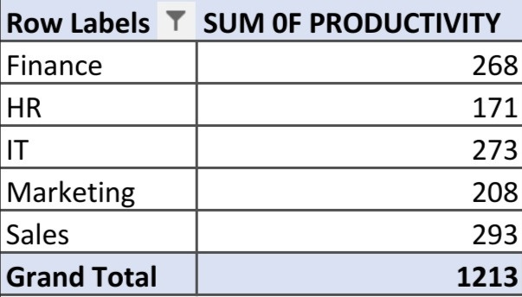
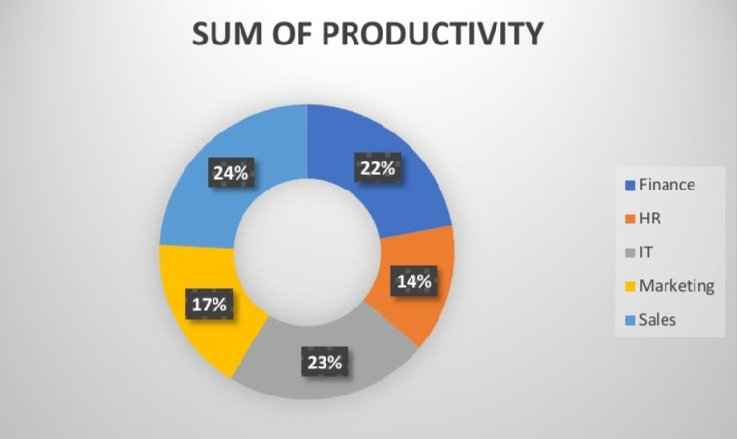
RESULTS
11

Slide 11
Conclusion
The analysis of the employee data set revealed key trends: demographic consistency, notable performance variations, and a balanced salary distribution with some disparities. Turnover was driven by specific factors, while training positively impacted retention. These insights suggest a need for targeted interventions to improve productivity and employee satisfaction.

